Slide 1
SECURE DATA HIDING IN IMAGE USING STEGNOGRAPHY
CAPSTONE PROJECT
Presented By:
Student Name : ALLIMILLI BARGAV KISHORE RAJA
College Name & Department :GOVERNMENT DEGREE COLLEGE(A), RAJAHMUNDRY

Slide 2
OUTLINE
Problem Statement
Technology used
Wow factor
End users
Result
Conclusion
Git-hub Link
Future scope

Slide 3
Problem Statement
The Problem involves securely hiding sensitive data within an image using steganography to ensure confidentiality and prevent unauthorized access . Traditional encryption methods make hidden data noticeable, whereas steganography conceals it within image pixels without altering the visual appearance. The challenge is to develop an efficient algorithm that embeds and extracts data while maintaining image quality and security.

Slide 4
Technology used
Libraries Used: open-cv and tkinter.
Modules Used: cv2 from open-cv, filedialog and messagebox from tkinter.
Platform: Python idle.

Slide 5
Wow factors
1.LSB-Based Steganography — Hides data in the Least Significant Bit , ensuring security without visible image changes.
2.Lossless BMP Processing – Works with uncompressed BMP images to maintain data integrity.
3.Simple CLI Interface – Easy command-line usage for embedding and extracting data , ideal for automation.

Slide 6
End users
1.Cybersecurity Professionals – Use steganography for secure data transmission and covert communication.
2.Forensic Experts – Extract hidden information from images for digital investigations.
3.Government & Defense Agencies – Securely embed sensitive data in images for intelligence and confidential operations.
4.Researchers & Academics – Study and improve steganography techniques for data security and cryptography.
5.Privacy-Concious Users – Individuals who want to protect personal or confidential information from unauthorized access

Slide 7
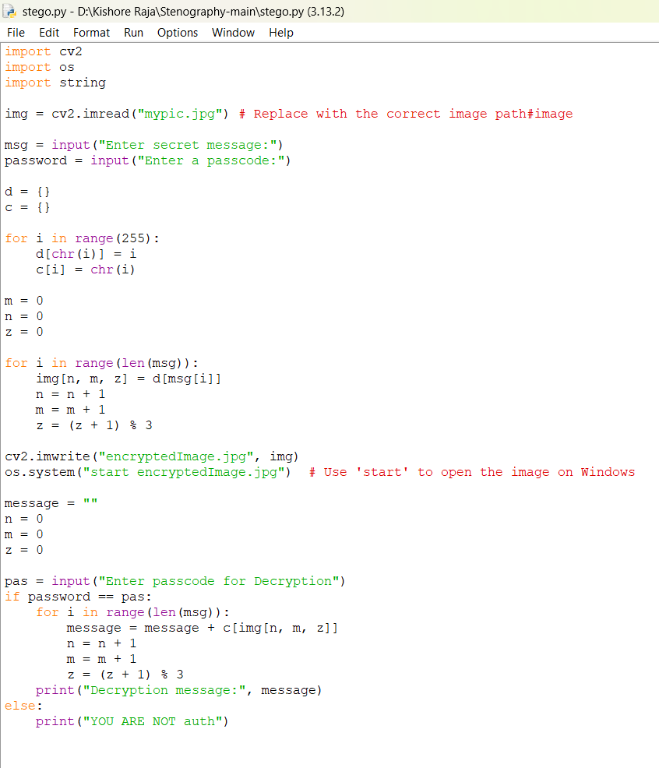
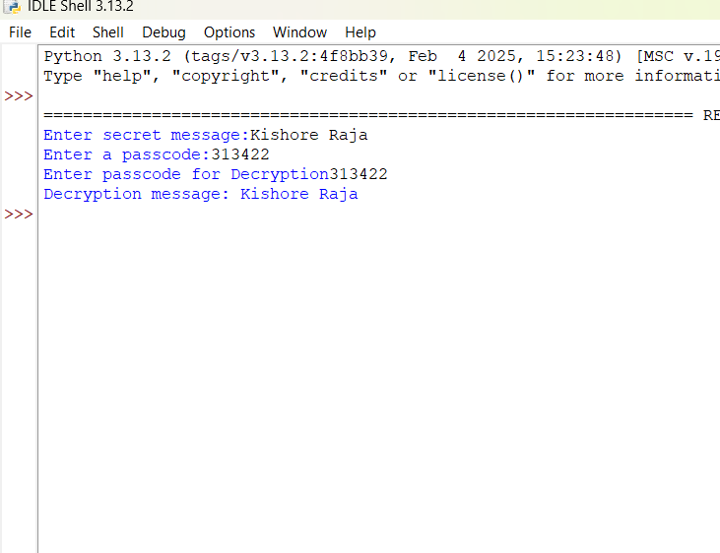
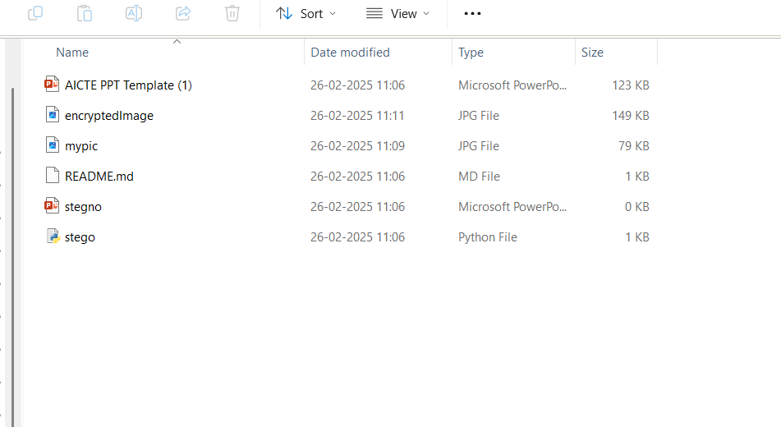
Results

Slide 8
Conclusion
This project successfully addresses the challenge of securely hiding data within an image using LSB-based steganography . By modifying the Least Significant Bit (LSB) of pixel values in BMP images , it ensures that sensitive information remains hidden without noticeable visuals changes. The approach maintains data integrity, works efficiently with minimal dependencies, and provides a simple CLI interface for embedding and extracting data. While the current implementation supports BMP files, it can be extended to support other formats like PNG or use DCT-based methods for JPEG. This project provides a lightweight, fast, and secure solution for data confidentiality, making it useful for cybersecurity, forensics, and private communication.

Slide 9
GitHub Link
https://github.com/Kishore-1212/My-Steganography.git
Repository contents:
•Source Code
•PPT Presentation
•README
•Encrypted image

Slide 10
Future scope(optional)
1.Cybersecurity & Data Protection – Used for covert communication, encryption, and anti-steganalysis techniques.
2.Digital Forensics & Law Enforcement – Helps detect hidden data in criminal investigations.
3.Blockchain & Cryptography – Enhances secure transactions and decentralized privacy.
4.Future communication – Enables secure messaging and convert data transmission.

Slide 11
THANK YOU

